Slide 1
Unit III
Switching
Vinit R Tribhuvan
vrt22.comp@coep.ac.in
1
Notes:
Data Communication

Slide 2
Introduction
Whenever we have multiple devices, we have the problem of how to connect them to make one-to-one communication possible.
Solution : point-to-point connection between each pair of devices (a mesh topology) or between a central device and every other device (a star topology).
Solution is impractical and wasteful when applied to very large networks
majority of those links would be idle most of the time
number and length of the links require too much infrastructure
Not cost effective
2
Notes:
Data Communication

Slide 3
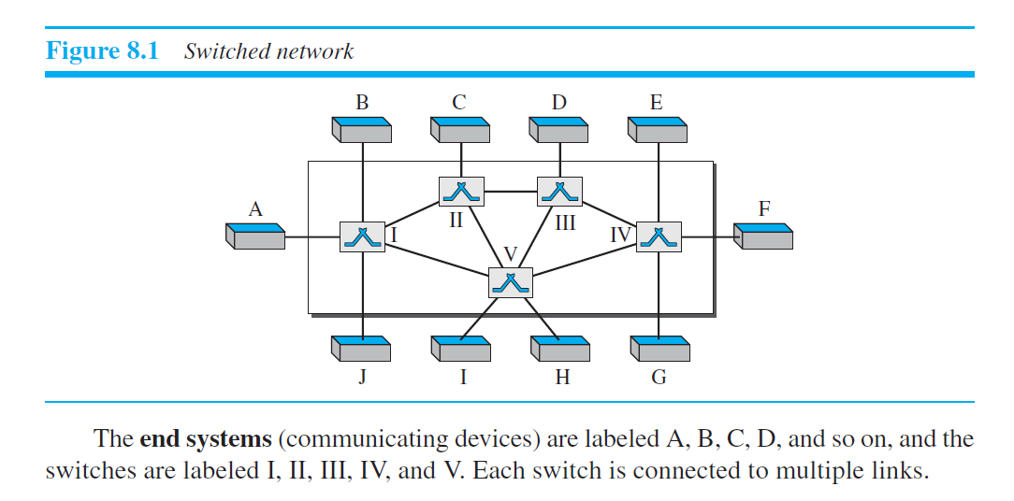
Better Solution?
Switching
A switched network consists of a series of interlinked nodes, called switches.
Capable of creating temporary connections between two or more devices linked to the switch.
some of these nodes are connected to the end systems (computers or telephones) others are used only for routing.
3
Notes:
Data Communication

Slide 4
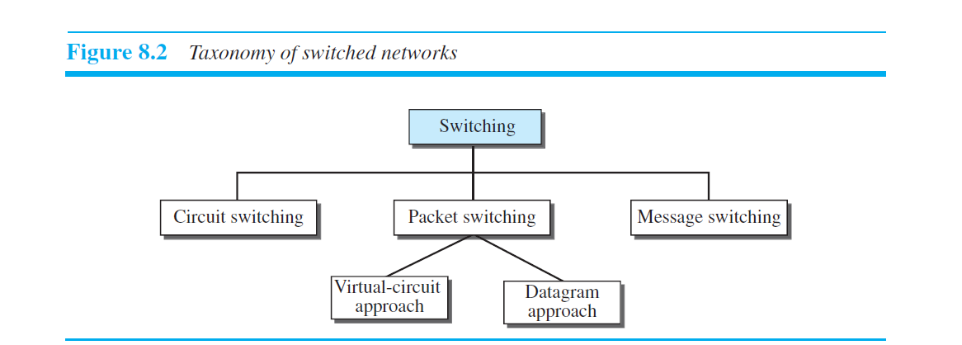
Three Methods of Switching
Traditionally, three methods of switching have been discussed:
circuit switching
packet switching
message switching
4
Notes:
Data Communication

Slide 5
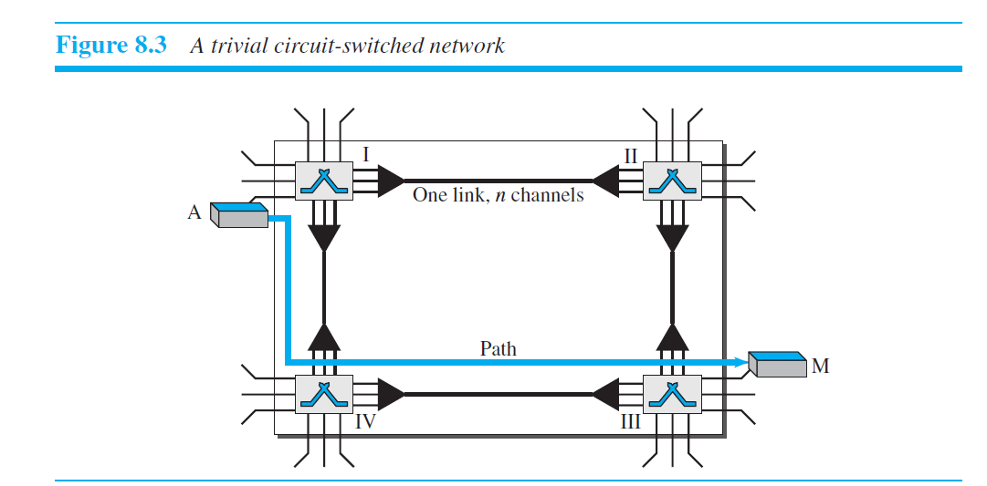
Circuit switching
A circuit-switched network consists of a set of switches connected by physical links.
Connection between two stations is a dedicated path made of one or more links.
Each connection uses only one dedicated channel on each link.
Each link is normally divided into n channels by using FDM or TDM

Slide 7
When end system A needs to communicate with end system M, system A needs to request a connection to M that must be accepted by all switches as well as by M itself. This is called the setup phase.
After the dedicated path is established, the data-transfer phase can take place.

Slide 8
Three phases
Circuit switching requires three phases:
Setup phase
Data Transfer phase
Teardown phase

Slide 9
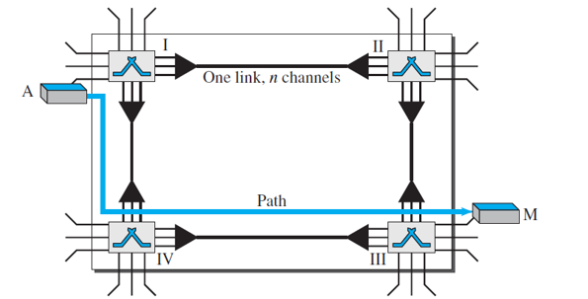
Setup Phase
A dedicated circuit (combination of channels in links) needs to be established for two parties to communicate.
Connection setup means establishing dedicated channels between switches.
Switch I finds a channel between itself and switch IV
Switch I then sends the request to switch IV
Switch IV finds dedicated channel between itself and switch III
Switch III informs system M of system A’s intention at this time
An acknowledgment from system M is sent in the opposite direction to system A
After system A receives this acknowledgment is the connection established.

Slide 10
Data-Transfer Phase
The two parties transfer the data in this phase

Slide 11
Teardown Phase
When one of the parties needs to disconnect, a signal is sent to each switch to release the resources.

Slide 12
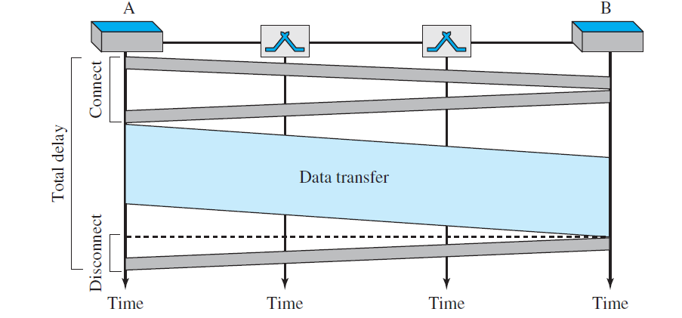
Issues in Circuit Switching
Delay

Slide 13
Delay
Delay is minimal
no waiting time at each switch
delay caused by the setup is the sum of four parts:
the propagation time of the source computer request (first slope)
the request signal transfer time (height of forst box)
the propagation time of the acknowledgment from the destination Computer (second slope)
the signal transfer time of the acknowledgment (height of second box)
The delay due to data transfer is the sum of two parts: the propagation time (slope of the colored box) and data transfer time (height of the colored box), which can be very long.

Slide 14
Efficiency
Inefficient since resources are allocated during the entire duration of the connection.
resources are unavailable to other connections.
other connections are deprived of resources.

Slide 15
Packet Switching
Message is divided into packets of fixed or variable size.
There is no resource allocation for a packet (bandwidth, processing time)
Packet is allocated on FCFS basis.
Two types of packet-switched networks:
datagram networks
virtual circuit networks

Slide 16
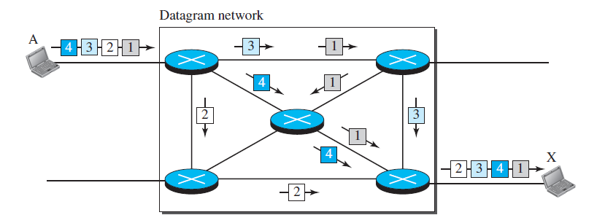
Datagram networks
Packets in this approach are referred to as datagrams.
Each packet is treated independently of all others.
Datagram switching is normally done at the Network Layer.

Slide 17
Datagram networks
All four packets (or datagrams) belong to the same message
Travel different paths to reach their destination.
Datagrams of transmission may arrive at their destination out of order with different delays between the packets. They may also be lost.
It is the responsibility of an upper-layer protocol to reorder the datagrams

Slide 18
Routing Tables in Datagram Networks
Each switch (or packet switch) has a routing table which is based on the destination address.
The routing tables are dynamic and are updated periodically.
The destination addresses and the corresponding forwarding output ports are recorded in the tables.
It has a port dedicated for every destination address.

Slide 19
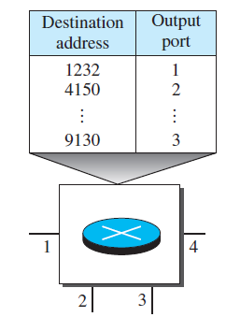
Routing Tables in Datagram Networks
Every packet in a datagram network carries a header that contains
the destination address of the packet.
the switch receives the packet, this destination address is examined;
the routing table is consulted to find the corresponding port
through which the packet should be forwarded.
This address remains the same during the entire journey of the
packet

Slide 20
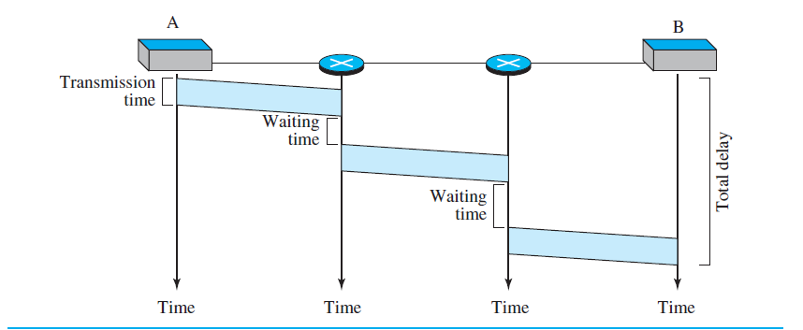
Issues
Delay
greater delay
each packet may experience a wait at a switch before it is forwarded.
Delay is not uniform as not all packets pass through same switches.
Considering the figure,
There are three transmission times (3T), three propagation delays (slopes 3τ of the lines), and two waiting times (w1 + w2).
We ignore the processing time in each switch.
Total delay = 3T + 3 τ + w1 + w2

Slide 21
Issues
Efficiency
The efficiency of a datagram network is better than that of a circuit-switched network;
Resources are allocated only when there are packets to be transferred.
Reallocation is done if there is delay in communication between two devices.

Slide 22
Virtual Circuit Network
A virtual-circuit network is a cross between a circuit-switched network and a datagram network.
Resources can be allocated during the setup phase, as in a circuit-switched network, or on demand, as in a datagram network.
all packets follow the same path established during the connection.
there are setup and teardown phases in addition to the data transfer phase.
A virtual-circuit network is normally implemented in the data-link layer, while a circuit-switched network is implemented in the physical layer and a datagram network in the network layer.

Slide 23
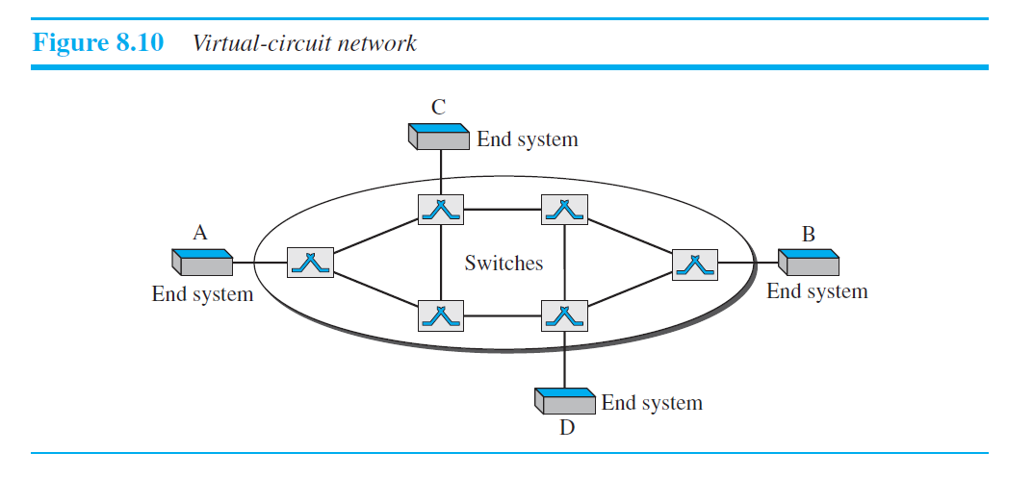
Virtual Circuit Network

Slide 24
Addressing in VCN
In a virtual-circuit network, two types of addressing are involved: global and local (virtual-circuit identifier).
Global – unique in the scope of the network or internationally
global address in virtual-circuit networks is used only to create a virtual-circuit identifier
The identifier that is actually used for data transfer is called the virtual-circuit identifier (VCI) or the label.
It is a small number that has only switch scope; it is used by a frame between two switches.

Slide 25
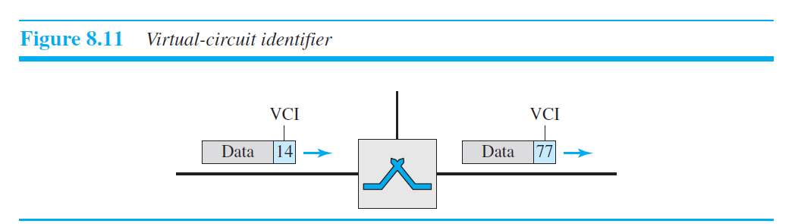
When a frame arrives at a switch, it has a VCI; when it leaves, it has a different VCI.

Slide 26
Three phases
V-Circuit switching requires three phases:
Setup phase
Data Transfer phase
Teardown phase

Slide 27
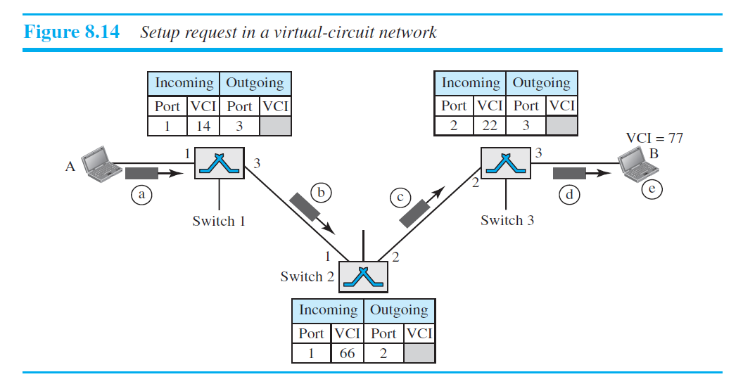


Setup phase
the source and destination use their global addresses to help switches make table entries for the connection.

Slide 28
Data Transfer phase
All switches need to have a table entry for this virtual circuit.
Table has four columns.
The switch holds four pieces of information for each virtual circuit
We assume that each switch has a table with entries for all active virtual circuits.

Slide 29
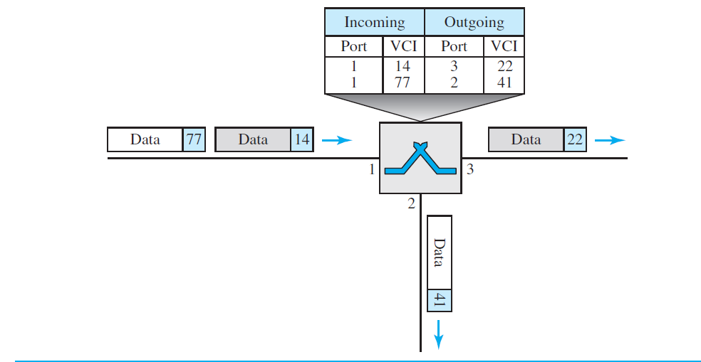
Data Transfer phase
Table
data-transfer phase is active until the source sends all its frames to the destination.

Slide 30
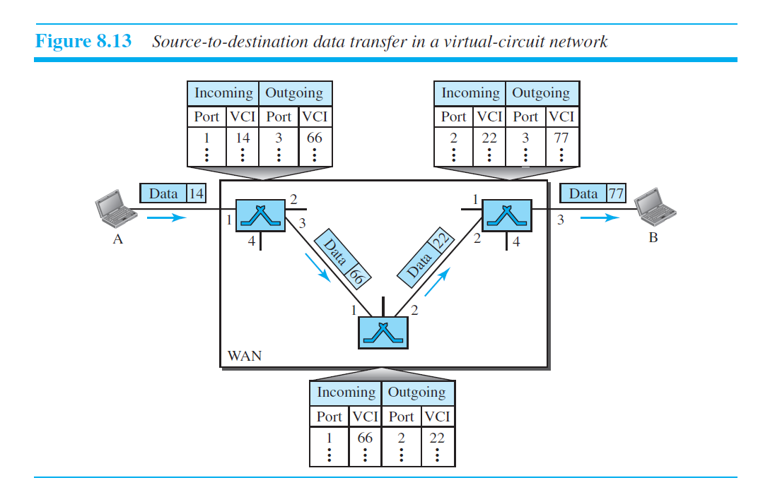
Data Transfer phase

Slide 31
Setup phase

Slide 32
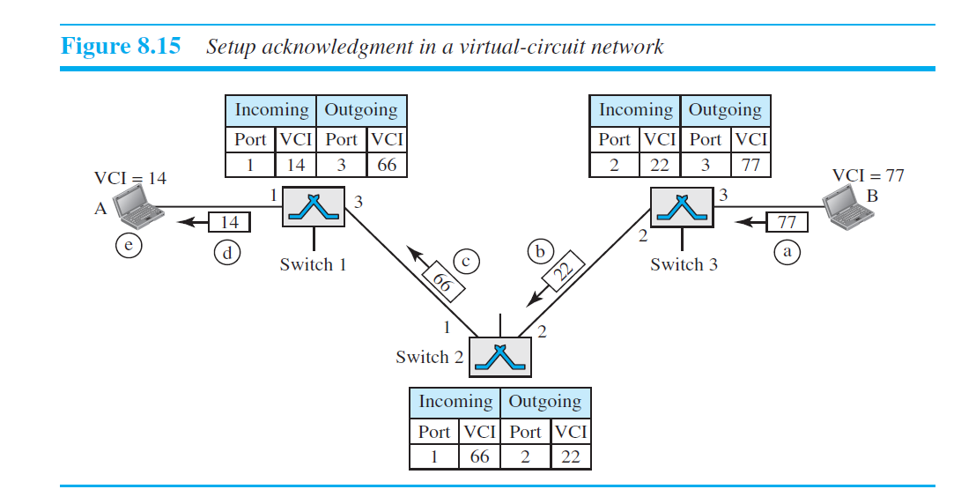
Acknowledgment in setup
A special frame, called the acknowledgment frame, completes the entries in the switching tables.

Slide 33
Teardown phase
In this phase, source A, after sending all frames to B, sends a special frame called a teardown request.
Destination B responds with a teardown confirmation frame. All switches delete the corresponding entry from their tables.

Slide 34
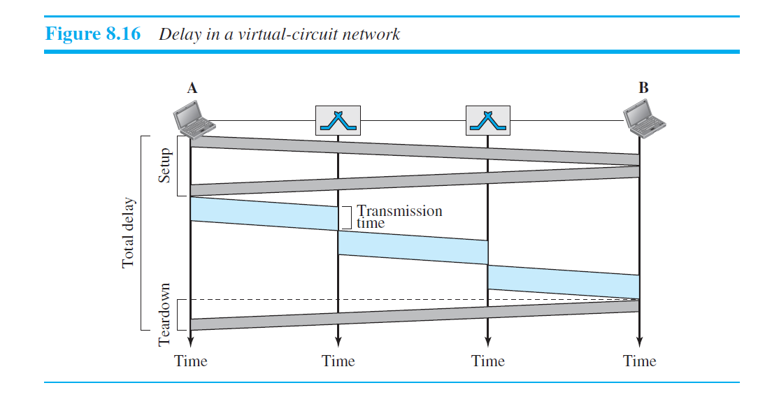
Delay

Slide 35
Delay
There are three transmission times (3T ), three propagation times (3τ), data transfer depicted by the sloping lines, a setup delay (which includes transmission and propagation in two directions), and a teardown delay (which includes transmission and propagation in one direction).

Slide 36
Efficiency
During setup, the delay for each packet is the same
During data transfer, each packet may encounter different delays
Resource allocation is on demand.The source can check the availability of the resources, without actually reserving it.

Slide 37
Switching in TCP/IP layers
Physical layer – only circuit switching. No packets exchanged.
Data Link layer - Packet switching at the data-link layer is normally done
using a virtual-circuit approach.
Network layer - packet switching. In this case, either a virtual-circuit approach or a datagram approach can be used.
App. Layer- only message switching. The communication at the application layer occurs by exchanging messages

Slide 38
Structure of switch
Crossbar switch
Multistage switch
Time Division switch
Time space time switch

Slide 39
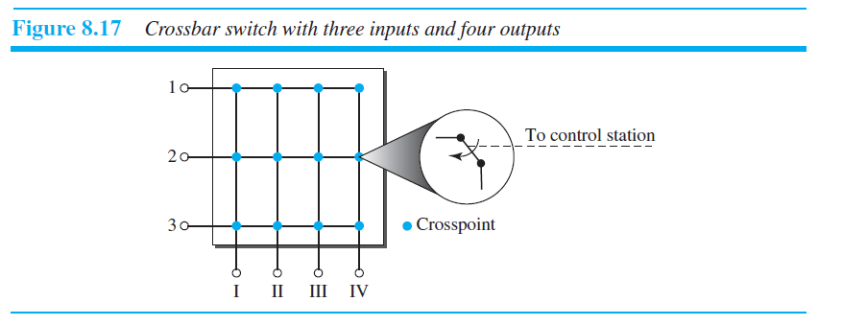
Crossbar switch
connects n inputs to m outputs in a grid, using electronic microswitches (transistors) at each crosspoint

Slide 40
Crossbar switch
to connect 1000 inputs to 1000 outputs requires a switch with 1,000,000 crosspoints.
this number of crosspoints is impractical.
fewer than 25 percent of the crosspoints are in use at any given time. The rest are idle.

Slide 41
Multistage switch
combines crossbar switches in several stages.
In a single crossbar switch, only one row or column (one path) is active for any connection.
So we need N x N crosspoints.
allowing multiple paths inside the switch, decreases the number of crosspoints.

Slide 42
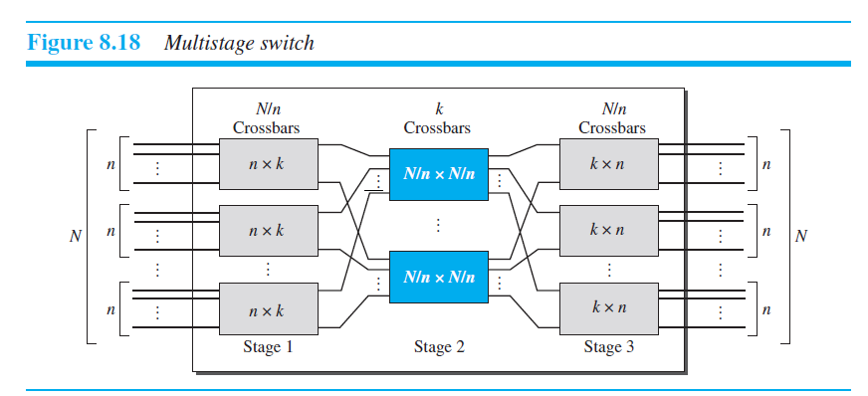
Multistage switch

Slide 43
Multistage switch
We divide the N input lines into groups, each of n lines. For each group, we use one crossbar of size n ⋅ k, where k is the number of crossbars in the middle stage. In other words, the first stage has N/n crossbars of n ⋅ k crosspoints.
We use k crossbars, each of size (N/n) ⋅ (N/n) in the middle stage.
We use N/n crossbars, each of size k ⋅ n at the third stage.
total number of crosspoints as follows

Slide 44
Multistage switch
Example
Design a three-stage, 200 ⋅ 200 switch (N = 200) with k = 4 and n = 20.

Slide 45
Multistage switch
Example
Design a three-stage, 200 ⋅ 200 switch (N = 200) with k = 4 and n = 20.
Solution
In the first stage we have N/n or 10 crossbars, each of size 20 ⋅ 4.
In the second stage, we have 4 crossbars, each of size 10 ⋅ 10.
In the third stage, we have 10 crossbars, each of size 4 ⋅ 20.
The total number of crosspoints is 2kN + k(N/n)², or 2000 crosspoints.
This is 5 percent of the number of crosspoints in a single-stage switch
(200 ⋅ 200 = 40,000).

Slide 46
Issues
Blocking
multistage switching share the crosspoints in the middle-stage crossbars.
Sharing can cause a lack of availability if the resources are limited
Blocking refers to times when one input cannot be connected to an output because there is no path available
Many people have experienced blocking on public telephone systems

Slide 47
Issues
Clos criteria for Blocking
In a nonblocking switch, the number of middle-stage switches must be
at least 2n – 1.
In other words, we need to have k >= 2n – 1
This n must be equal to or greater than (N/2)^{1/2}
the total number of crosspoints is greater than or equal to 4N [(2N)^{1/2} – 1]

Slide 48
Example
Design a three-stage, 200 ⋅ 200 switch (N = 200) with k = 4 and n = 20., using the Clos criteria with a minimum number of crosspoints

Slide 49
Solution
Design a three-stage, 200 ⋅ 200 switch (N = 200) with k = 4 and n = 20., using the Clos criteria with a minimum number of crosspoints
We let n = (200/2)1/2, or n = 10. We calculate k = 2n – 1 = 19.
First stage : 10x2=20, crossbars, each with 10 × 19 crosspoints
Second stage : 19 crossbars, each with 10 × 10 crosspoints.
Third stage, we have 20 crossbars each with 19 × 10 crosspoints.
total number of crosspoints is
20(10 × 19) + 19(10 × 10) + 20(19 × 10) =9500

Slide 50
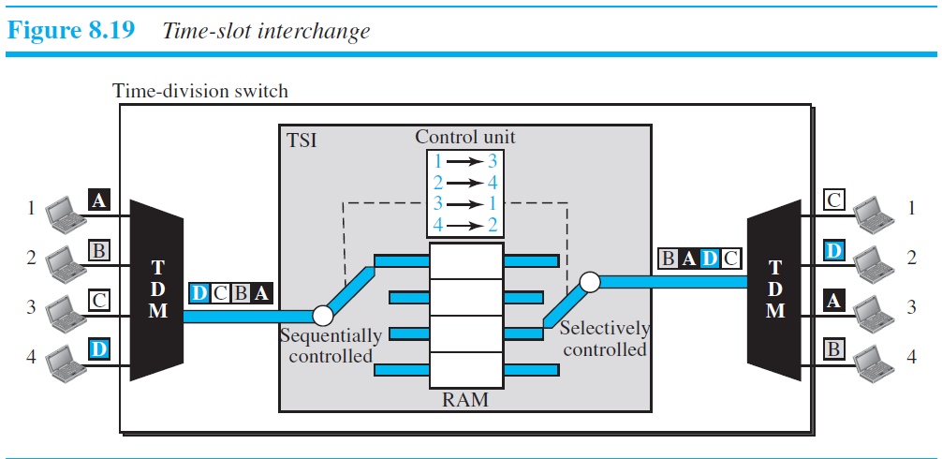
Time Division Switch
Uses TDM

Slide 51
Time Division Switch
advantage of time-division switching is that it needs no crosspoints.
disadvantage is that processing each connection creates delays

Slide 52
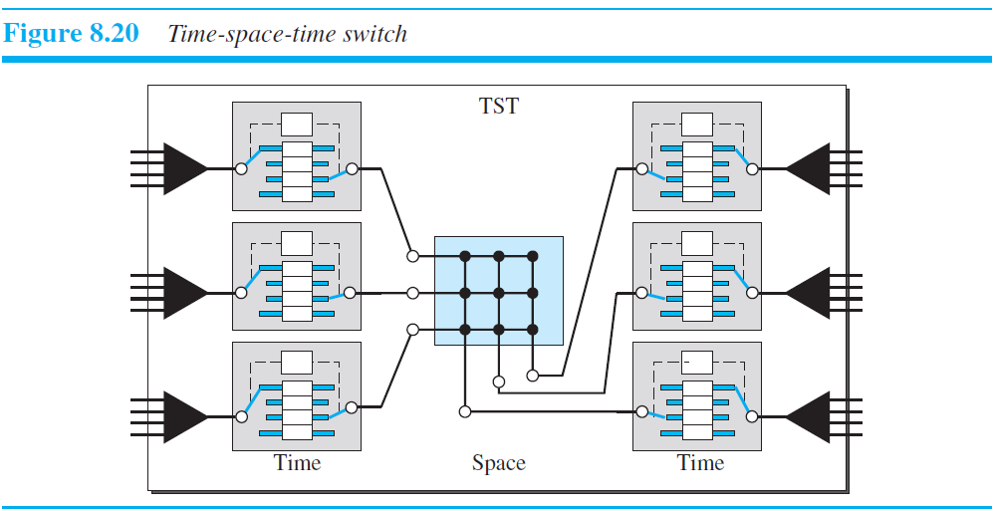
Time Space Time switch
the average delay is one-third of what would result from using one time-slot interchange to handle all 12 inputs

Slide 53
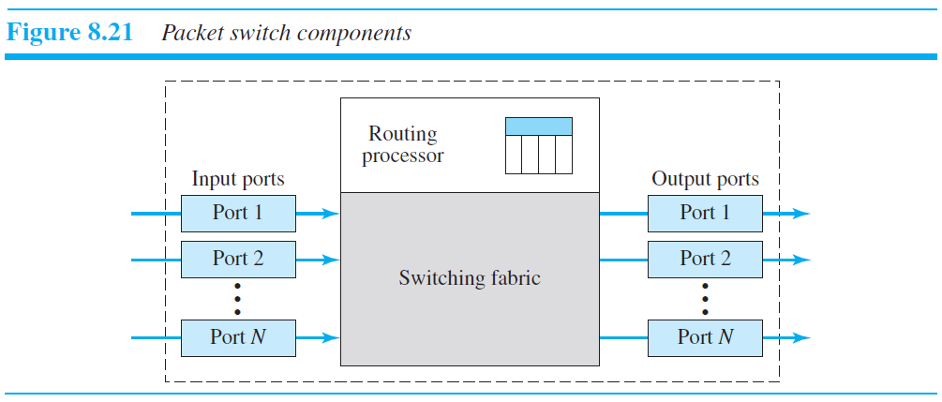
Packet Switch

Slide 54
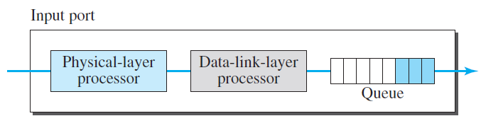

Input ports
performs the physical and data-link functions of the packet switch
The packet is decapsulated from the frame
the input port has buffers (queues) to hold the packet before it is directed to the switching fabric.

Slide 55
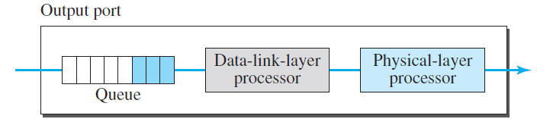
Output ports
performs the same functions as the input port, but in the reverse order.
the outgoing packets are queued, then the packet is encapsulated in a frame.
the physical-layer functions are applied to the frame to create the signal to be sent on the line.

Slide 56
Routing processor
The routing processor performs the functions of the network layer.
The destination address is used to find the address of the next hop and the output port number from which the packet is sent out.
This activity is sometimes referred to as table lookup.

